Slide 1

The Business of Learning: 15 Steps to Running Learning Like a Business
Presented by:
Dave Vance
President, Manage Learning LLC
Former president, Caterpillar University
Author, The Business of Learning
To:
ASTD Lincoln Chapter
Southeast Community College Continuing Ed Center
April 21, 2011

Slide 2
How would you characterize most learning in your organization?
Strategic and planned proactively (before the year begins)
Strategic but planned just in time
Timely but not necessarily strategic
Most is not strategic and should have been planned sooner

Slide 3

Steps 1 and 2
Appreciate that learning is a business
Resolve to run it like a business
Implies that
  Learning should produce measurable results
  Must be planned carefully
  And executed with discipline
  Also, that numbers will be involved!

Slide 4


Steps 3-6
Adopt a strategic focus
Create a board of governors
Create vision and mission statements
Create a multi-year plan to achieve your vision
  This will be your journey
  Manage expectations
  Communicate

Slide 5
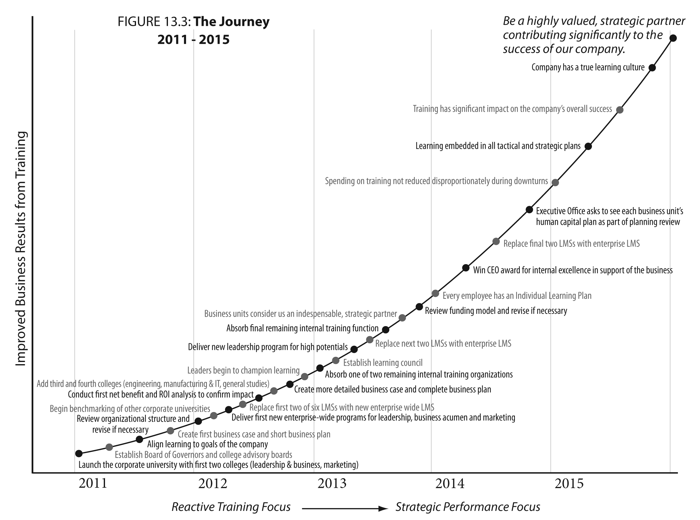

Slide 6

Steps 7 and 8
Ensure that your organizational structure will support a strategic focus
  Centralized or hybrid
Adopt a workable funding model
  Often will be a combination of corporate, allocation and discretionary (charge back)

Slide 7

Step 9: Strategically Align Learning to your Organization’s Goals
Start with the business and strategic plan
Meet with the CEO, senior leaders, key stakeholders
  Understand company goals and challenges
  Learn the priorities
  These are business discussions

Slide 8

Step 9: Strategically Align Learning to your Organization’s Goals (cont.)
Perform a “macro” level needs analysis to determine if learning has a role to play in achieving these goals
Make a preliminary determination of recommended learning programs and their alignment to the prioritized company goals

Slide 9



Strategic Alignment of Learning

Slide 10



Step 10: Build the Business Case for Learning
The business case brings together the expected impact (and perhaps benefits) of the recommended learning and the costs
  Impact: Increase in sales, reduction in injuries, or an increase in productivity (often these can be dollarized)
  Cost: Budget costs (design, development, delivery, reinforcement) and opportunity cost
  Net benefit or ROI (if appropriate)

Slide 11
2011 Summary Business Case

Slide 12
2011 Detailed Business Case without Gross and Net Benefits
 |  |  |  |  |  |  |  |  |  | Thousands of Dollars
 |  |  |  |  |  |  | Expected % |  |  |  | Opport-
 |  |  |  |  | Unique | Total | Impact on |  |  | Budget | unity | Total
Priority | Organization Objective |  | Key Learning Programs | Target Audience | Participants | Participants | Corp Obj | Impact of Learning |  | Cost | Cost | Cost
1 | Increase customer satisfaction |  | Customer service skills (new) | Call center employees | 20 | 20
 | score by 10% |  | New services information (revised) | Call center employees | 20 | 20
 |  |  | Total key programs |  | 40 | 40 | 50% | 5% higher customer satisfaction |  | $25 | $19 | $44
2 | Reduce complaints by 20% |  | Billing course (new) | Accounting employees | 10 | 10
 |  |  | Service Sched. & Mgt course (new) | Logistics employees | 15 | 15
 |  |  | Total key programs |  | 25 | 25 | 70% | 14% reduction in complaints |  | $35 | $14 | $49
3 | Reduce Injuries by 25% |  | Five Safety courses (3 new) | Transportation ee's | 100 | 500
 |  |  | One Safety course (revised) | Division managers | 15 | 15
 |  |  | Two Safety courses (1 new) | Office employees | 250 | 500
 |  |  | Total key programs |  | 365 | 1,015 | 60% | 15% reduction in injuries |  | $65 | $45 | $110
4 | Improve leadership |  | Intro to supervision (revised) | New supervisors | 10 | 10
 | score by 5 points |  | Leadership for managers (new) | Division managers | 15 | 15
 | on employee survey |  | Advanced leadership (existing) | Department heads | 5 | 5
 |  |  | Total key programs |  | 30 | 30 | 40% | 2 point increase |  | $35 | $40 | $75
5 | Increase retention by |  | Individual development plans | All employees | 550 | 550
 | 10 points |  | Performance mgt (new) | Mgt employees | 285 | 285
 |  |  | Total key programs |  | 835 | 835 | 30% | 3 point increase |  | $18 | $32 | $50
 |  |  |  |  | ====== | ====== | ==== |  |  | ====== | ====== | ======
Total for Top Five Priorities |  |  | Learning for Top Five Objectives |  | 1,295 | 1,945 |  | Range = 30%-70% |  | $143 | $110 | $253
 |  |  | Courses: 9 New , 3 Revised

Slide 13
Does your learning organization follow a business plan for learning?
Yes, of course
Yes, but is is not a written document
No, not really
We’re working on that now
We’re moving in that direction

Slide 14

Step 11: Create the Business Plan for Learning
Ideally, a written document with the following chapters:
  Executive Summary
  Last Year’s Accomplishments
  Strategic Alignment
  Business Case for Learning
  Learning Resources, Expenditures, Budget
  Detailed Work Plans
  Evaluation Strategy

Slide 15


Step 11: Create the Business Plan for Learning (continued)
Created with input from CEO, governing bodies, stakeholders, learning professionals
Approved by CEO and governing body
Very scalable: An L&D function with just one person can still do this

Slide 16


Step 12: Plan for Monthly, Disciplined Execution of the Plan
Create scorecards to measure progress against goals
Calendar at least one staff meeting per month dedicated to a review of your progress
Share progress at least quarterly with the board of governors and/or CEO

Slide 18

Step 13: Adopt an Evaluation Strategy that Ensures Planned Impact is Achieved and Provides for Continuous Improvement
Start with the basics and add as you go
Sample strategy:
  Level 0: number of participants, courses, completion dates, costs
    All courses
  Level 1: reaction
    All courses, not necessarily all participants
  Level 2: learning
    Where appropriate. All compliance courses

Slide 19


Step 13: Adopt and Evaluation Strategy that Ensures Planned Impact is Achieved and Provides for Continuous Improvement
Sample strategy (continued):
  Level 3: application
    Select courses
  Level 4: impact
    A few key courses
  Level 5: ROI or Net Benefit
    A few key courses
Purpose: Ensure results and improve

Slide 20


Steps 14 and 15
14. Use business and economic concepts to make better decisions
  Like opportunity cost and marginal analysis
15. Benchmark with others. Learn. Improve.
Remember, it is a multiyear journey.
The goal is continuous improvement

Slide 21
Questions?
Dave Vance
dave@poudrerivergroup.com
Resources
The Business of Learning: How to Manage Corporate Training to Improve Your Bottom Line by Dave Vance
Available at poudrerivergroup.com or at Amazon.com
A 36-page Sample Business Plan for Learning
(PDF, Word and Excel files) available at poudrerivergroup.com

